Slide 1
How Metadata Catalogs collaborate with ODPi Egeria
Mandy Chessell, IBM

Slide 2
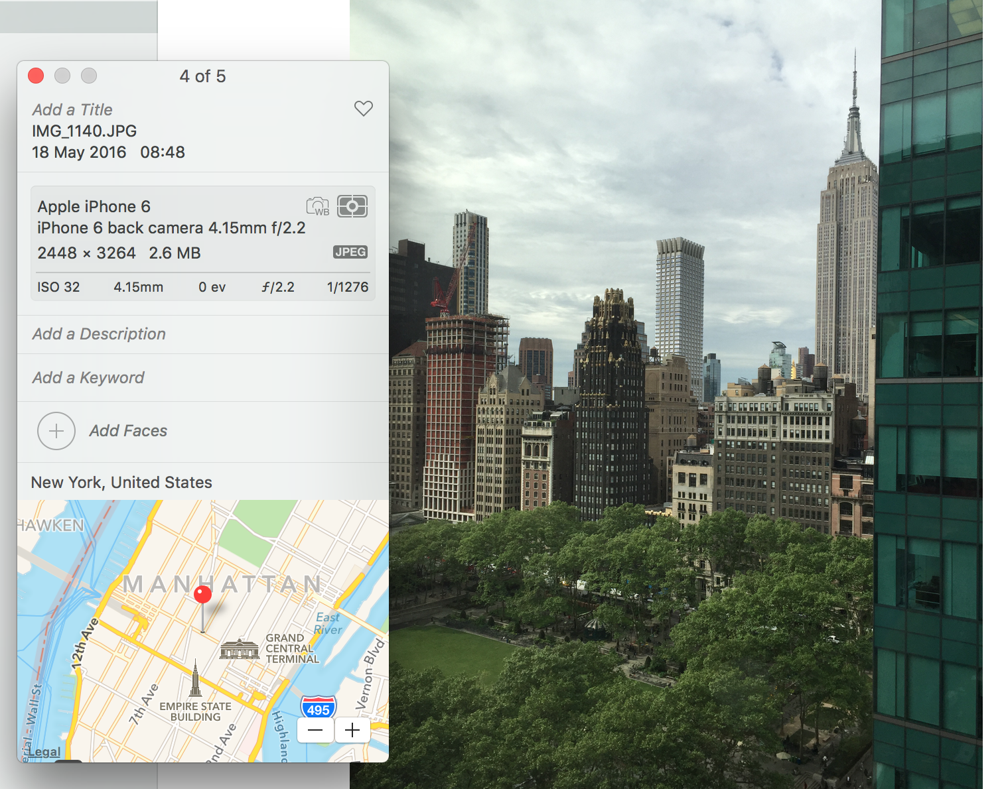
What is metadata?
2
Notes:
AUTOMATED – Metadata is created by application at the same as the data is created in a standard manner easily consumable for all with necessary permissions
Device that took the picture / name of picture / settings picture was taken at / location geo tag of picture etc – all automatic – all done at creation of data time

Slide 3
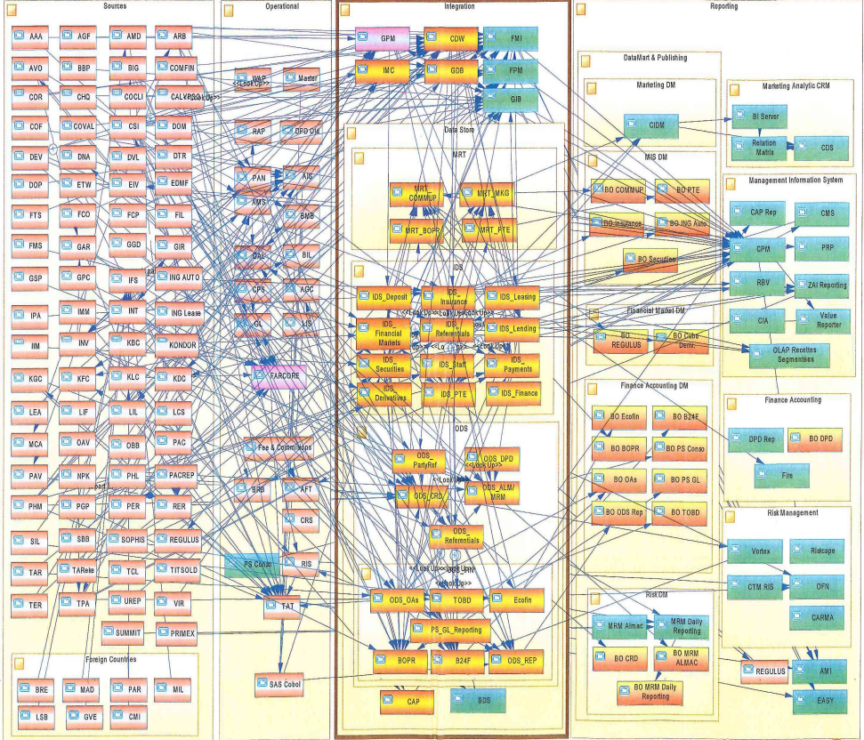
Real Data Landscapes
Many enterprises have had 40 years of innovation embedded into their IT Systems.
Data Science projects spend a lot of time finding and validating data.
There is often a delay moving real-time analytics from POC into production.

Slide 4


Curation
Callie Quartile
Data Scientist
I wonder what this means
00 3809890 6 7 Lemmie Stage 818928 3082 4 New York 4 27 DataStage Expert 1 45324 300 27 Code St Harlem NY 1 3
00 3809890 3 7 Callie Quartile 328080 7432 5 New York 4 27 Data Scientist 1 56944 045 27 Code St Harlem NY 1 3
00 3809890 1 7 Tanya Tidie 209482 4051 2 New York 4 27 Data Steward 1 43800 215 27 Code St Harlem NY 1 3
I know
Faith Broker
Human Resources

Slide 5
Scared to share
Very Sensitive Data
Very Sensitive Data
Faith Broker
Human Resources
00 3809890 6 7 Lemmie Stage 818928 3082 4 New York 4 27 DataStage Expert 1 45324 300 27 Code St Harlem NY 1 3
00 3809890 3 7 Callie Quartile 328080 7432 5 New York 4 27 Data Scientist 1 56944 045 27 Code St Harlem NY 1 3
00 3809890 1 7 Tanya Tidie 209482 4051 2 New York 4 27 Data Steward 1 43800 215 27 Code St Harlem NY 1 3
00 3809890 6 7 Lemmie Stage 818928 3082 4 New York 4 27 DataStage Expert 1 ##### ### 27 Code St Harlem NY 1 3
00 3809890 3 7 Callie Quartile 328080 7432 5 New York 4 27 Data Scientist 1 ##### ### 27 Code St Harlem NY 1 3
00 3809890 1 7 Tanya Tidie 209482 4051 2 New York 4 27 Data Steward 1 ##### ### 27 Code St Harlem NY 1 3
Callie Quartile
Data Scientist

Slide 6

Using a metadata repository to describe data
Metadata
Repository

Slide 7
What does metadata look like?
Business
metadata
IS-A
Employee
Sensitive
HAS-A
Work Location
HAS-A
HAS-A
Hourly Pay Rate
Manager
Compensation Plan
HAS-A
IS-A
HAS-A
Job Title
IS-A
HAS-A
Employee Id
Annual Salary
Employee Name
Structural
metadata for
a data store
EmpName
EmpNo
JobCode
Salary
Employee Record
Data
00 3809890 6 7 Lemmie Stage 818928 3082 4 New York 4 27 DataStage Expert 1 45324 300 27 Code St Harlem NY 1 3
Notes:
Business metadata describes the data that the business needs, what it means and how it should be classified and protected.
Structural metadata describes how the data is actually stored and labelled in the data store.
The linkage between the business and technical metadata allows our technology to switch between these two perspectives. For example,
A request for data expressed in business terminology can be translated into a query for data from a data store.
An integration engine copying data into a sand box can discover which are the fields that the business classifies as sensitive and then mask these values dynamically.

Slide 8
Today’s reality – organizations buy lots of tools

Slide 9
What needs to change?
Open and
Unified Metadata

Slide 10
Two levels of services
Search
Domain
Specific
Open Metadata Access Services
Open Metadata Repository Services
Domain
Agnostic

Slide 11
Through the Repository Services
{
"class": "EntityDetailResponse",
"relatedHTTPCode": 200,
"entity": {
"class": "EntityDetail",
"type": {
"class": "InstanceType",
"typeDefCategory": "ENTITY_DEF",
"typeDefGUID": "578a3510-9ad3-45fe-8ada-e4e9572c37c8",
"typeDefName": "GovernanceOfficer",
"typeDefVersion": 1,
"typeDefDescription": "Person responsible for a governance domain.",
"typeDefSuperTypes": [
{
"guid": "a32316b8-dc8c-48c5-b12b-71c1b2a080bf",
"name": "Referenceable"
}
],
"validInstanceProperties": [
"qualifiedName",
"additionalProperties",
"title",
"scope",
"domain"
]
},
"createdBy": "julesk",
"createTime": "2018-09-11T13:01:20.139+0000",
"version": 1,
"instanceProvenanceType": "LOCAL_COHORT",
"metadataCollectionId": "87b06ffe-9db2-4ef5-ba6e-8127480cf30d",
"guid": "fd7d41e7-70f5-42ec-86d3-88683e599494",
"instanceURL": "http://localhost:8080/instances/entity/fd7d41e7-70f5-42ec-86d388683e599494",
"properties": {
"class": "InstanceProperties",
"instanceProperties": {
"title": {
"class": "PrimitivePropertyValue",
"instancePropertyCategory": "PRIMITIVE",
"primitiveDefCategory": "OM_PRIMITIVE_TYPE_STRING",
"primitiveValue": "Chief Data Officer (CDO)"
},
"qualifiedName": {
"class": "PrimitivePropertyValue",
"instancePropertyCategory": "PRIMITIVE",
"primitiveDefCategory": "OM_PRIMITIVE_TYPE_STRING",
"primitiveValue": "EXEC-CDO"
},
"domain": {
"class": "EnumPropertyValue",
"instancePropertyCategory": "ENUM",
"ordinal": 1,
"symbolicName": "Data",
"description": "The data (information) governance domain."
}
},
"propertyNames": [
"qualifiedName",
"domain",
"title"
],
"propertyCount": 3
},
"status": "ACTIVE"
}
}
http://localhost:8080/open-metadata/repository-services/users/julesk/instances/entity/fd7d41e7-70f5-42ec-86d3-88683e599494
Type
Control
Properties

Slide 12
Through the governance program access service
{
"class": "GovernanceOfficerResponse",
"relatedHTTPCode": 200,
"governanceOfficer": {
"class": "GovernanceOfficer",
"guid": "fd7d41e7-70f5-42ec-86d3-88683e599494",
"type": "GovernanceOfficer",
"title": "Chief Data Officer (CDO)",
"governanceDomain": "DATA",
"appointmentId": "EXEC-CDO",
"appointee": {
"guid": "0760ac98-69e2-4309-ab1d-53377b105d0a",
"type": "GovernancePost",
"profile": {
"guid": "053435b5-b19f-434d-bdd5-f6c909f55cb3",
"type": "Person",
"employeeNumber": "026",
"fullName": "Julian Keeper",
"knownName": "Jules Keeper",
"jobTitle": "Chief Data and Privacy Officer",
"jobRoleDescription": "Ensuring CocoP makes the best use of data.",
"additionalProperties": {
"ContactType": "Employee",
"WorkLocation": 2
}
}
}
}
}
http://localhost:8080/open-metadata/access-services/governance-program/users/julesk/leadership/governance-officers/fd7d41e7-70f5-42ec-86d3-88683e599494
Governance Officer
Governance Post
Person

Slide 13
Open Metadata Management and Governance
Search
Open Metadata Access Services
Open Metadata Repository Services

Slide 14
Example of a simple cohort
Data Lake
Cohort A
Chief Data Office
Systems of Record

Slide 15
First server
The first server to join the cohort issues a registration request and waits for others to join.

Slide 16
Establishing contact
When another server joins the cohort they exchange registration information.

Slide 17
Federated queries
Once the registration is complete the cohort members can query each other.

Slide 18
Caching metadata for availability and performance
Metadata can also be replicated through the cohort

Slide 19
Importance of the distributed graph model
Database
Column
Glossary Term
Server 1
Server 2
Entity
Entity

Slide 20
Importance of the distributed graph model
Database
Column
Glossary Term
Glossary
Term
Meaning
Server 1
Server 2
Reference
Copy
Relationship

Slide 21
Importance of the distributed graph model
Database
Column
Glossary
Term
Server 1
Server 2
Database Column
Glossary
Term
Meaning
Server 3

Slide 22
Importance of the distributed graph model
Database
Column
Glossary
Term
Server 1
Server 2
Entity
Proxy
Database
Column
Glossary
Term
Meaning
Server 3

Slide 23
Automating governance example
Define Policies
Hadoop Metadata
Open
Governance APIs
Access
Data
IBM
Information
Governance
Catalog
Apache Atlas
Egeria
configure
Gaian
configure
Apache Ranger
Manage Data Access
Egeria
(Open metadata exchange and federated queries)

Slide 24
IBM Information Governance Catalog Integration
IGC uses the Adapter Pattern
There are two connectors to IGC in the repository proxy server.
They translate IGC APIs and events into open metadata APIs and events.
Egeria handles the interaction with the cohort.
Repository Proxy
Information
Governance
Catalog
ODPi Egeria
Repository Connector
Event Mapper Connector
Open Metadata Highway

Slide 25
Apache Atlas Integration
Apache Atlas uses the Native Pattern
There are two connectors to Apache Atlas that translate Atlas APIs and events into open metadata APIs and events.
ODPi Egeria handles the interaction with the cohort.
The connectors and the ODPi Egeria libraries reside in the Atlas server
ODPi Egeria
Apache
Atlas
Repository Connector
Event Mapper Connector
Open Metadata Highway

Slide 26
Metadata and governance digital platform
Governance Platform
Reporting Platform
Analytics Platform
Open Metadata and Governance
Data Platform
ETL Platform
Virtualization Platform

Slide 27
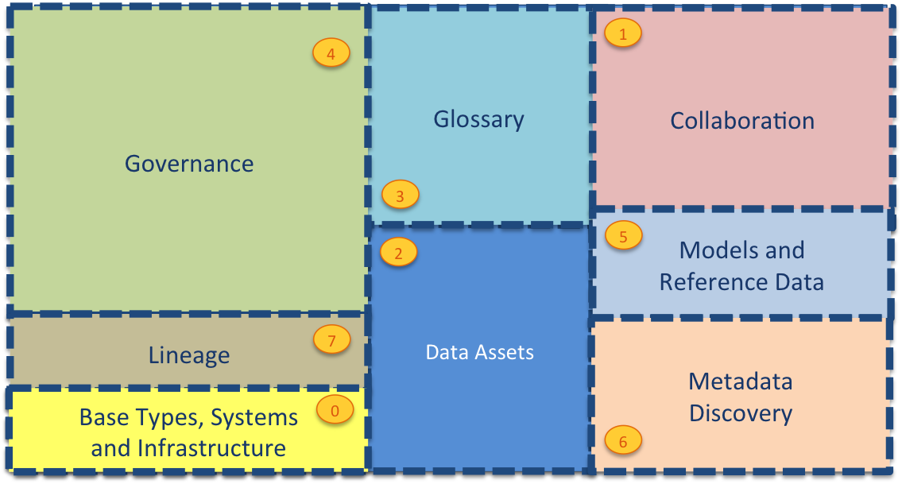
Current Open Metadata Access Services (OMASs)
Asset Consumer
Asset Owner
Asset Lineage
Subject Area
Asset Catalog
Community Profile
Stewardship Action
Project Management
Information View
Data Science
Governance Program
Software Developer
Data Privacy
Digital Architecture
Data Process
Data Protection
DevOps
Governance Engine
Data Infrastructure
Data Platform
Connected Asset
Discovery Engine

Slide 28






Realizing open metadata and governance
Delivering core technology
Recruiting vendors
Assisting practitioners
Core Technology
Vendors
Project
Egeria
Compliance Suite
Practitioners
Best Practices
Project
Data
Governance

Slide 29
Help wanted
Governance practice leaders needed to build out best practices
If you buy data technology please encourage your vendors to consume the Egeria technology.
Looking for developers:
UI development
Graph repository (eg JanusGraph/TinkerPop)
Python clients
Join the ODPi to help fund our work
Tell everyone about want we do

Slide 30
Open forum
z
z
z
z
z
z
z
Questions?

Slide 31
Links
Press Release and Podcast
Open source repositories
https://www.linuxfoundation.org/press-release/2018/08/odpi-announces-egeria-for-open-sharing-exchange-and-governance-of-metadata/
https://roaringelephant.org/2018/09/25/episode-107-open-metadata-and-governance-masterclass-with-mandy-chessell-part-1/
https://roaringelephant.org/2018/10/09/episode-109-open-metadata-and-governance-
masterclass-with-mandy-chessell-part-2/
https://github.com/odpi/data-governance
https://github.com/odpi/egeria
31

Slide 32
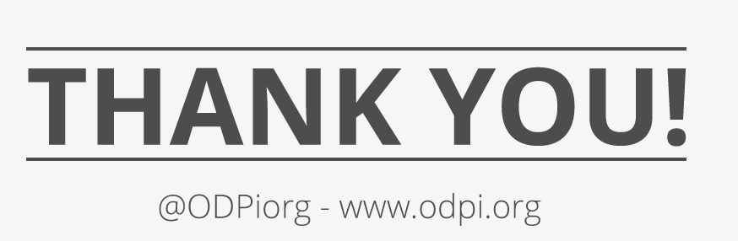
32

